Slide 1
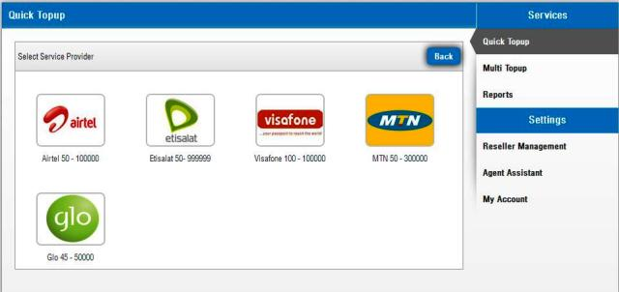
Arizona Mobifin VTU Presentation
By
P.C. Controllers Ltd
www.pccontrollers.net
info@pccontrollers.net
08097015999

Slide 2

Arizona Mobifin VTU Presentation
If you use android phone, please download Arizona mobifin app from the Android Playstore or Blackberry World if you are blackberry user. Search for app using the keyword ARIZONA MOBIFIN.
When you find the app. Download, open and install the app. After installation, click register and register your mobile app with the registration details we sent to or that you we would send to you.
To get your phone IMEI no dial *#06#

Slide 3
To register your app on your mobile phone, please enter your given id no and login id (check your email), enter ur personal password and transaction pin known to you only. Login & confirm your account balance.
If you use java enabled phones open your internet browser and type
http://arizonaadmin.mobifinng.com/arizona-j2me/Arizona.jar
and repeat the above registration details

Slide 4
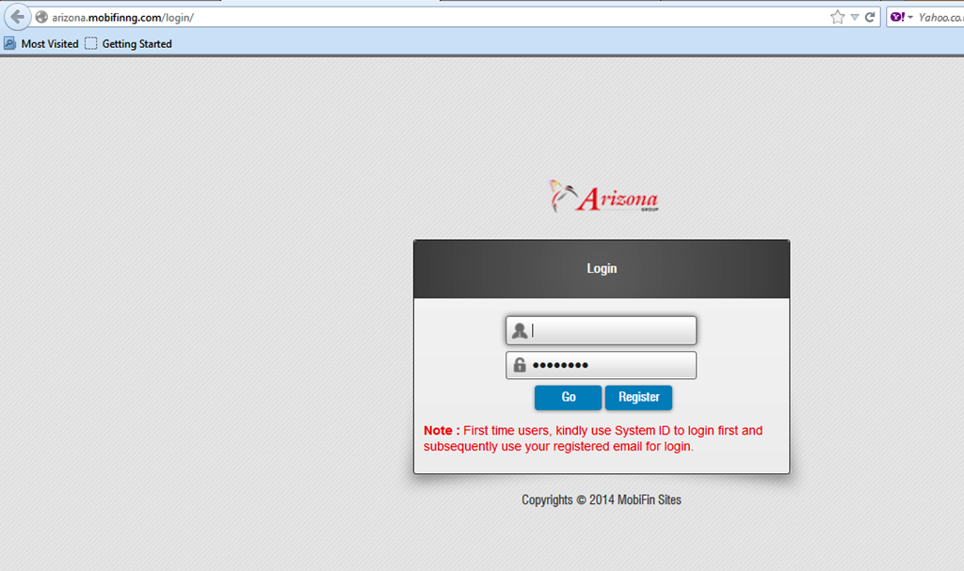
Arizona Mobifin VTU Presentation
To login into your web account please enter the url into your web browser
http://arizona.mobifinng.com/login/ which will bring you to your login page. Enter your login id number or email address and your given password. First time login would require you to change your given password (mandatory)

Slide 5
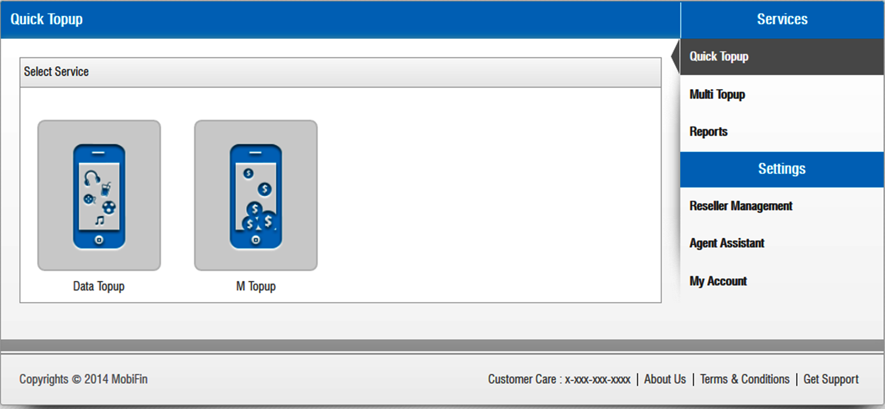
You will see this page after you have succeeded in login into your account. Click on M Topup if you want to top up a mobile phone number or click on Data Topup if you want to buy a data plan
Click here

Slide 6
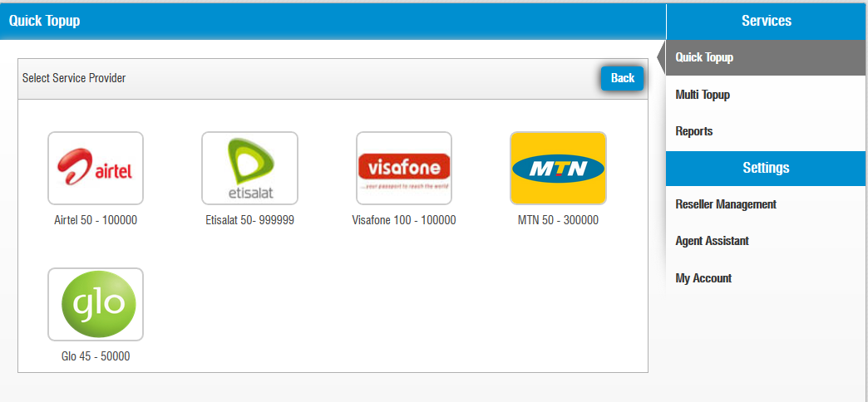
Click on the service provider logo you want to top up its mobile phone number

Slide 7
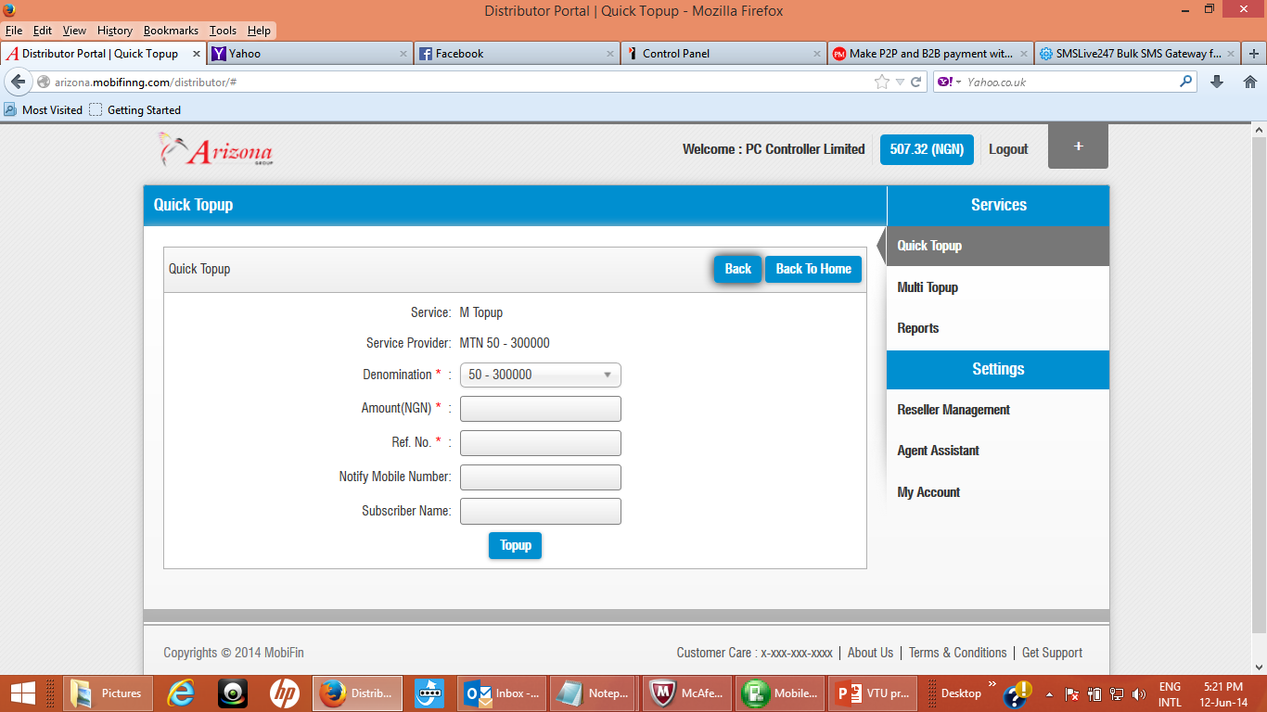
Fill the mandatory amount of airtime you want to top up, the Ref No. (ie the subscriber phone number) the notifying mobile number and the subscriber name if you wish. Click Topup.

Slide 8
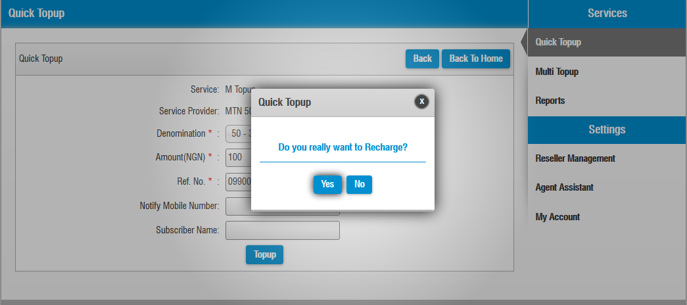
This page appears for you to reconfirm. Click yes to confirm. Please note once confirmed it cannot be reversed

Slide 9
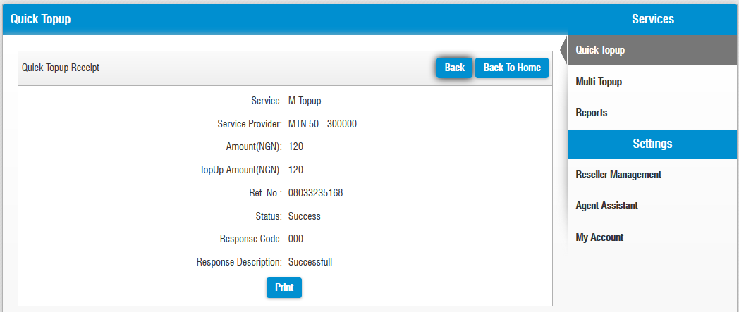
You will see this confirmation/receipt page if you are error free but if there is an error please check and resend. You may click print if you have a printer or need a receipt.

Slide 10
Click on Data Top up if you want to buy a data plan
Click here
Click here

Slide 11
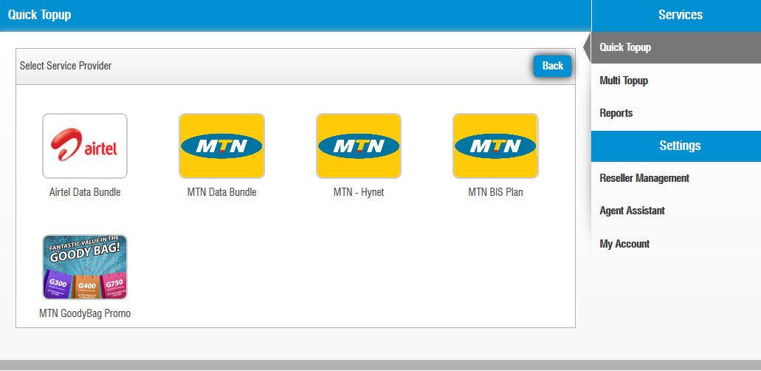
Click on the service provider logo you want to top up its data plan

Slide 12
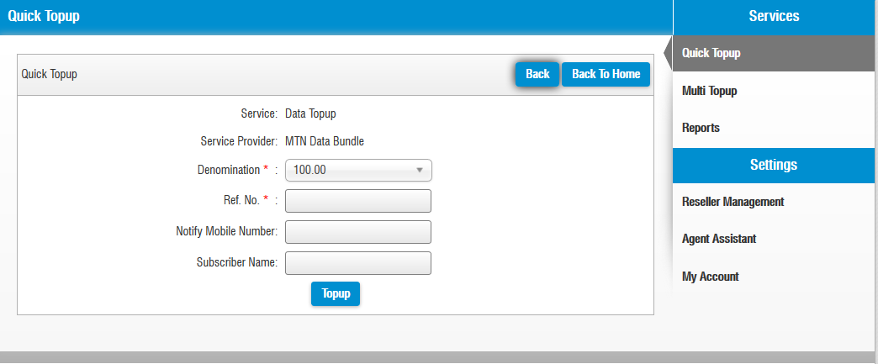
Fill the mandatory amount of airtime you want to top up, the Ref No. (ie the subscriber phone number) the notifying mobile number and the subscriber name if you wish. Click Topup, a small confirmation page appears. Click yes to confirm. Please note once confirmed it cannot be reversed.

Slide 13
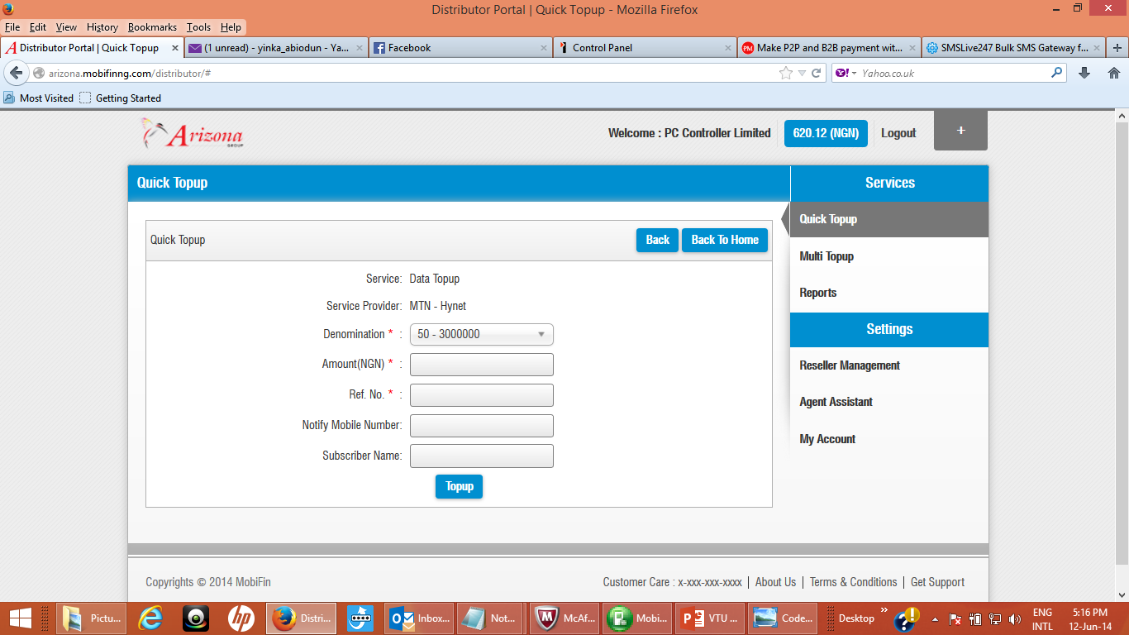
Fill the mandatory amount of airtime you want to top up, the Ref No. (ie the subscriber phone number) the notifying mobile number and the subscriber name if you wish. Click Topup, a small confirmation page appears. Click yes to confirm. Please note once confirmed it cannot be reversed.

Slide 14
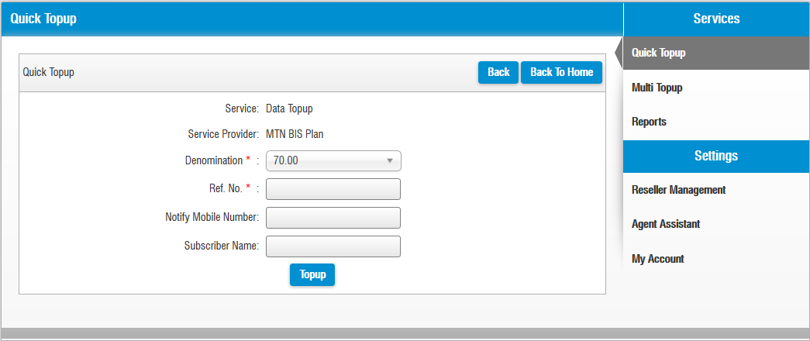
Fill the mandatory amount of airtime you want to top up, the Ref No. (ie the subscriber phone number) the notifying mobile number and the subscriber name if you wish. Click Topup, a small confirmation page appears. Click yes to confirm. Please note once confirmed it cannot be reversed.

Slide 15
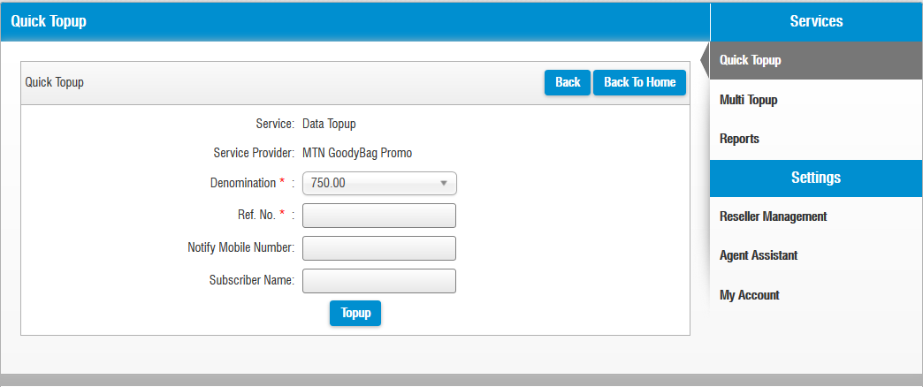
Fill the mandatory amount of airtime you want to top up, the Ref No. (ie the subscriber phone number) the notifying mobile number and the subscriber name if you wish. Click Topup, a small confirmation page appears. Click yes to confirm. Please note once confirmed it cannot be reversed.

Slide 16
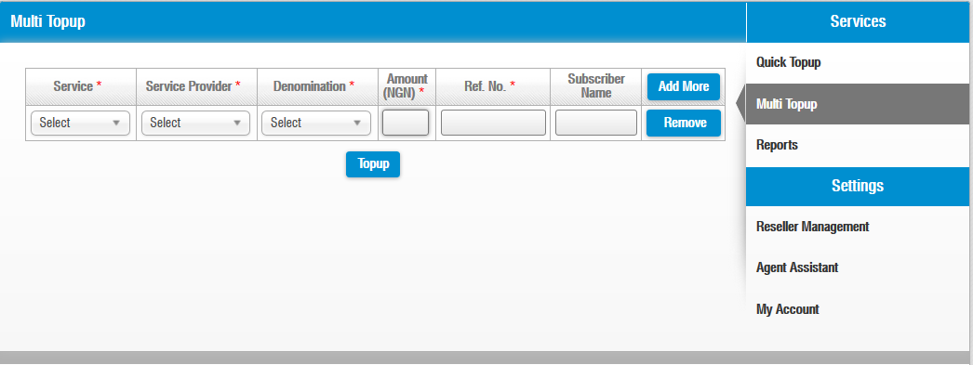
To top up more than one phone number. Click on Multi Top up fill the mandatory fields in red asterisks and click Top up. To add more than one phone number click on Add More or Remove if you want to delete the added phone number(s)
Click here

Slide 17
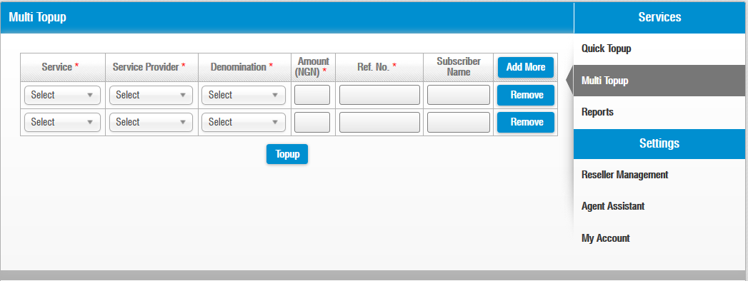
To add more than one phone number click on Add More or Remove if you want to delete the added phone number(s)

Slide 18
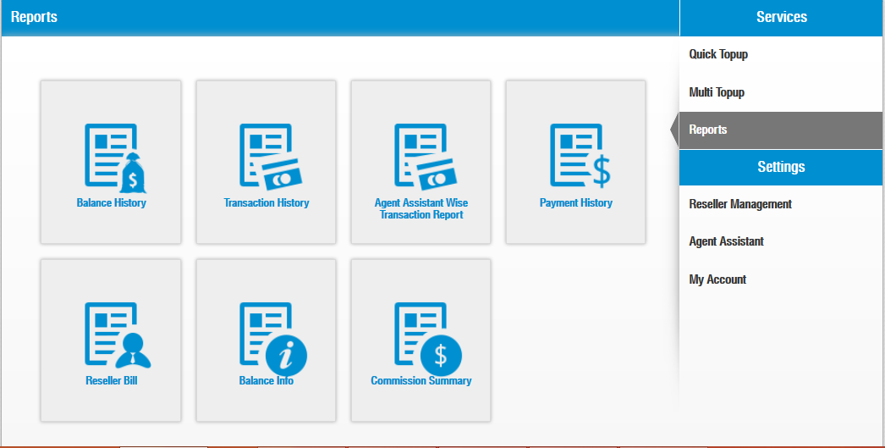
To view diverse reports of your account activities click on the Reports and the related icons below. To top up your reseller agents account under your account Click on Reseller Bill.
Click here
Click here

Slide 19
Click on Reseller drop down menu and look for the name of your reseller agent name.
Click here

Slide 20
Click on the payment icon and fill in the Mandatory Amount you want to top up your reseller, the Payment Date and a brief Description of the transaction and click Update.
Click here

Slide 21
Click on Reseller Management to see all your resellers in your account. To Add, Edit and View a particular reseller check the radio button of the reseller and click on Edit to edit an existing account, click on view to view an existing account and click on Add if you want to add a new reseller account.
Radio
Button
Click here

Slide 22
When you click on Add Reseller (in Reseller Management) a new reseller account form appears, Fill the mandatory fields in red asterisks

Slide 23
Fill the mandatory fields in red asterisks (contd.)

Slide 24
Fill all the mandatory fields in red asterisks, select status to be active, select your choice of the Allow Access and Data Topup you want for your reseller agent and click Submit

Slide 25
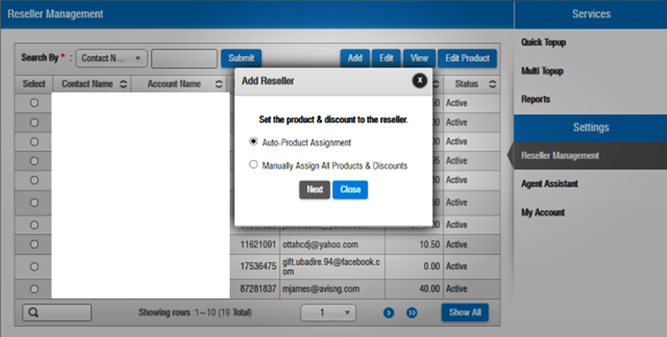
After you submit this page appears for you to Edit your products either Manually or by Auto. When you click on either you can now give discounts to your resellers

Slide 26
Edit Reseller Password (in Reseller Management) allows you to alter the selected reseller’s account setup details
Click here to give or edit your reseller password

Slide 27
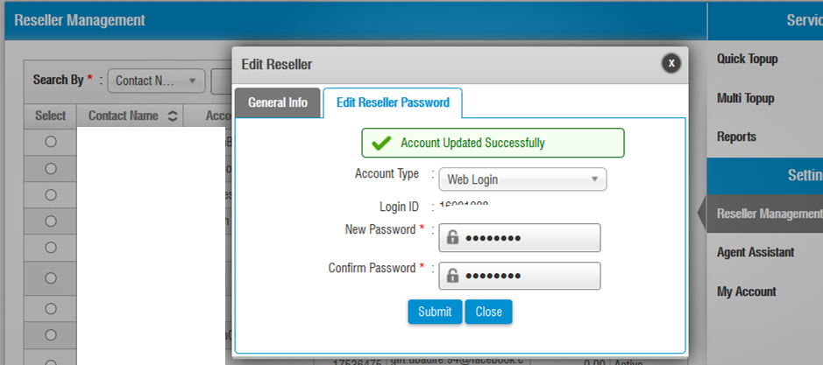
This page allows you to give or edit both Web login and Mobile passwords for your resellers.
Click here to give or edit your reseller password

Slide 28
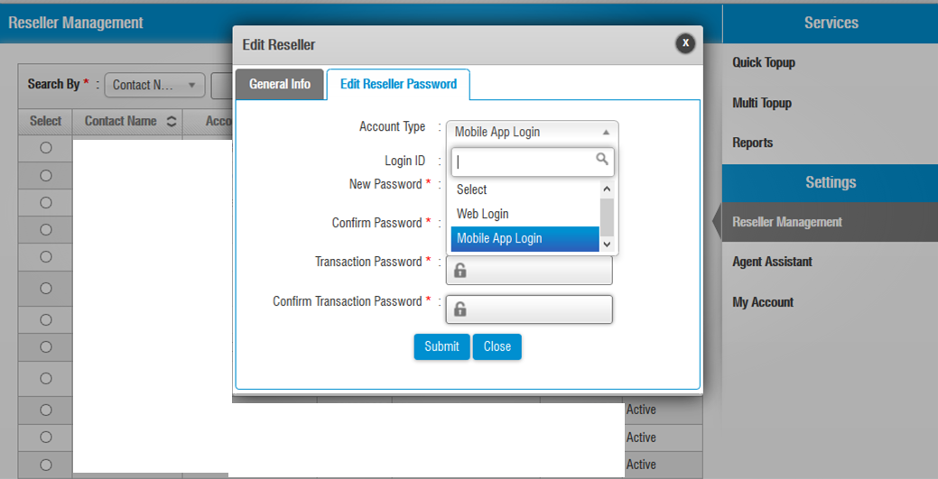
When you click on Account Type drop down icon you can give or edit Password and Transaction Password for your resellers Mobile Apps

Slide 29
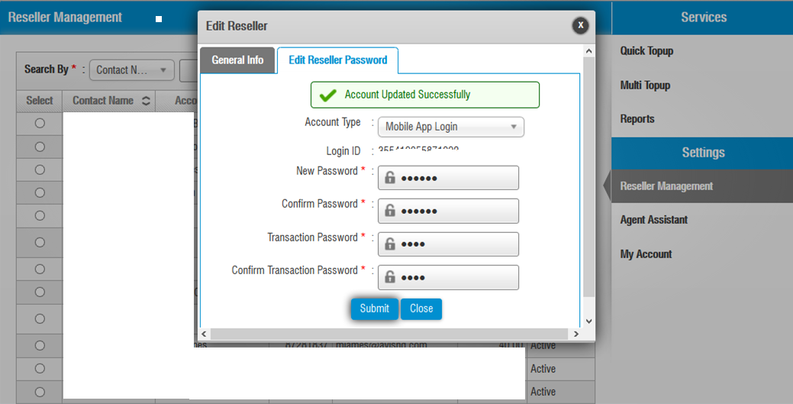
Click on Submit, if Account update is successful the message below appears else an error message appears

Slide 30
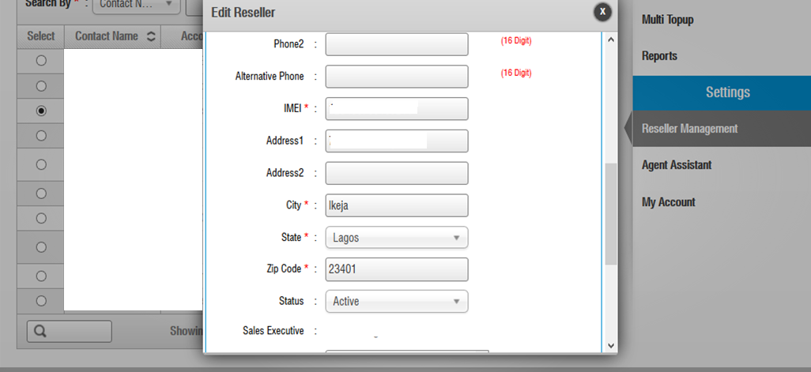
.
Edit Reseller Password (in Reseller Management) allows you to alter the selected reseller’s account setup details Contd.

Slide 31
Edit Reseller Password (in Reseller Management) allows you to alter the selected reseller’s account setup details Contd.

Slide 32
View Reseller allows you to see the selected reseller’s account setup details

Slide 33
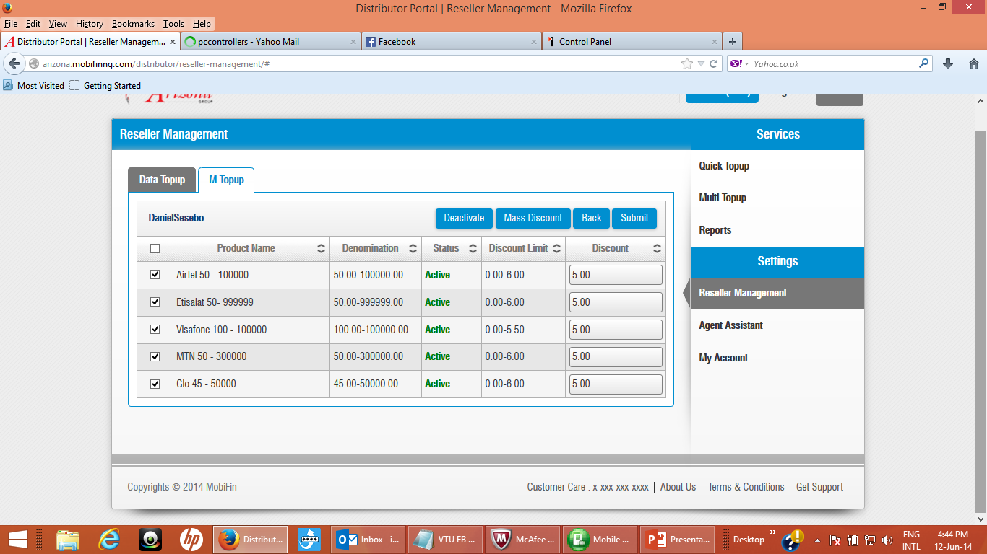
Click Edit Product (Data Topup) in Reseller Management allows you to edit/make selected product status active in the selected reseller’s account. Click on all the products radio button, enter discount and Submit in status drop down to make products active
Radio
Button

Slide 34
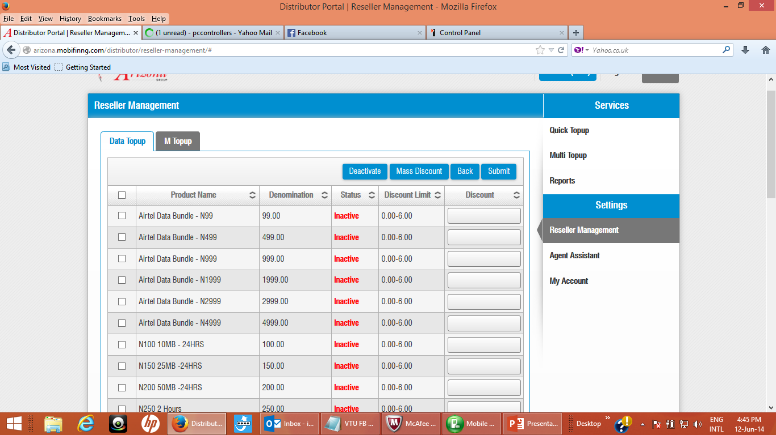
Click Edit Product (Data Topup) in Reseller Management allows you to edit/make selected product status active in the selected reseller’s account. Click on all the products radio button and Submit to make products active. Also put desired figures as discounts
Radio
Button

Slide 35
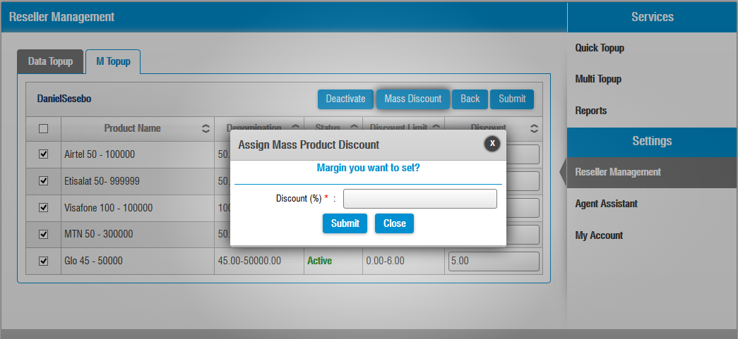
Click Mass Discount (Data Topup) in Reseller Management allows you to edit/put desired global figures as discounts. To give required discount to your agent enter your desired figure and click submit.

Slide 36
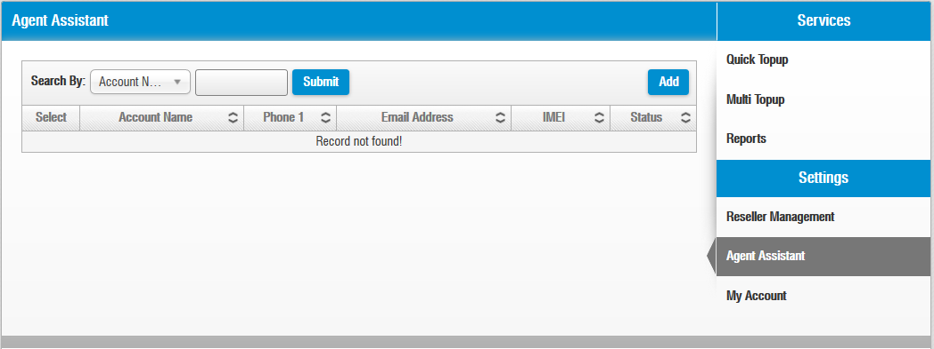
Click Add to add an Agent Assistant that you can share your account login details with. Please note your Agent Assistant can do as much on your account as much as the access you give him.
Click here
Click here

Slide 37
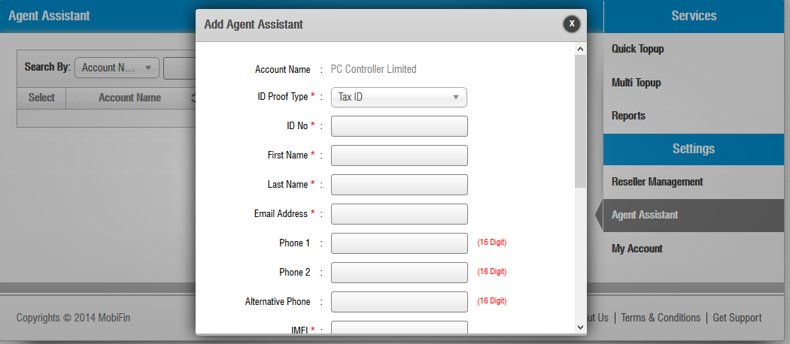
Fill all the mandatory fields in red asterisks to create an Agent Assistant account.

Slide 38
Click on MY Account to view your personal account details.
Click here

Slide 39
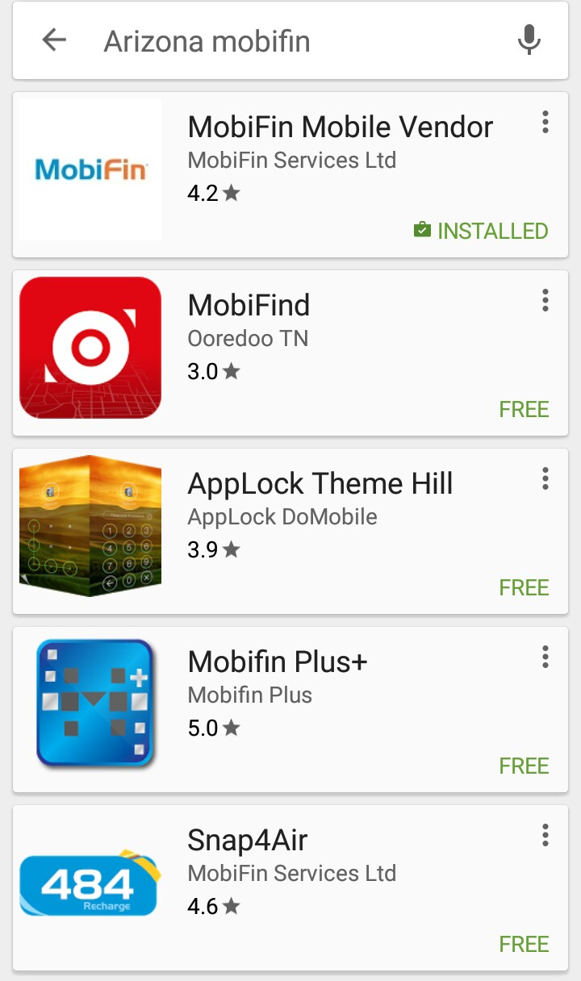
How to download and register your mobifin mobile app
Go to your phone mobile apps store and search for ARIZONA MOBIFIN
Download and install app

Slide 40
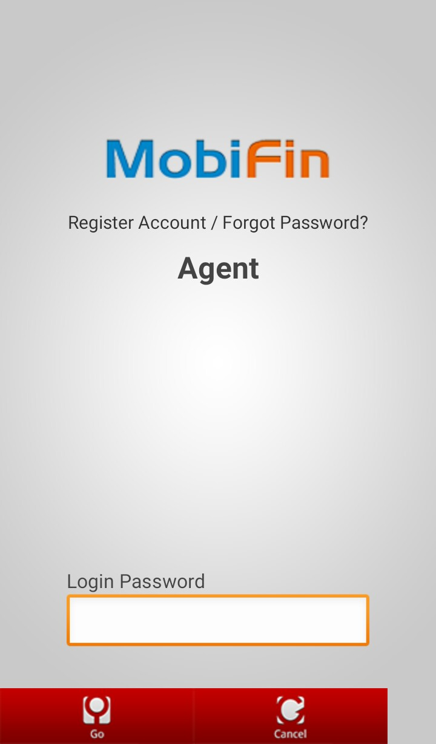
Click on Register Account

Slide 41
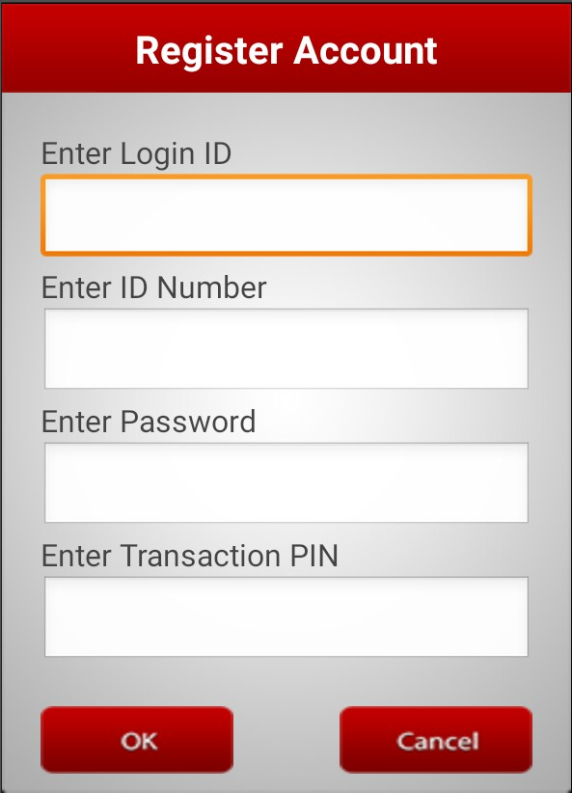
Enter Login ID number sent to you
Enter ID Number sent to you, please note ID number is also same as Activation Key
Enter your desired password known to you
Enter your Transaction Pin known to you

Slide 42
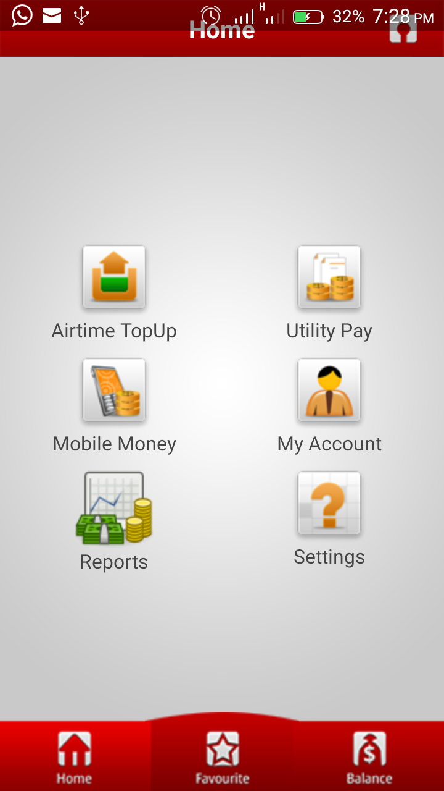
How to Top up your phone using your mobifin mobile app
Click on Airtime Topup

Slide 43
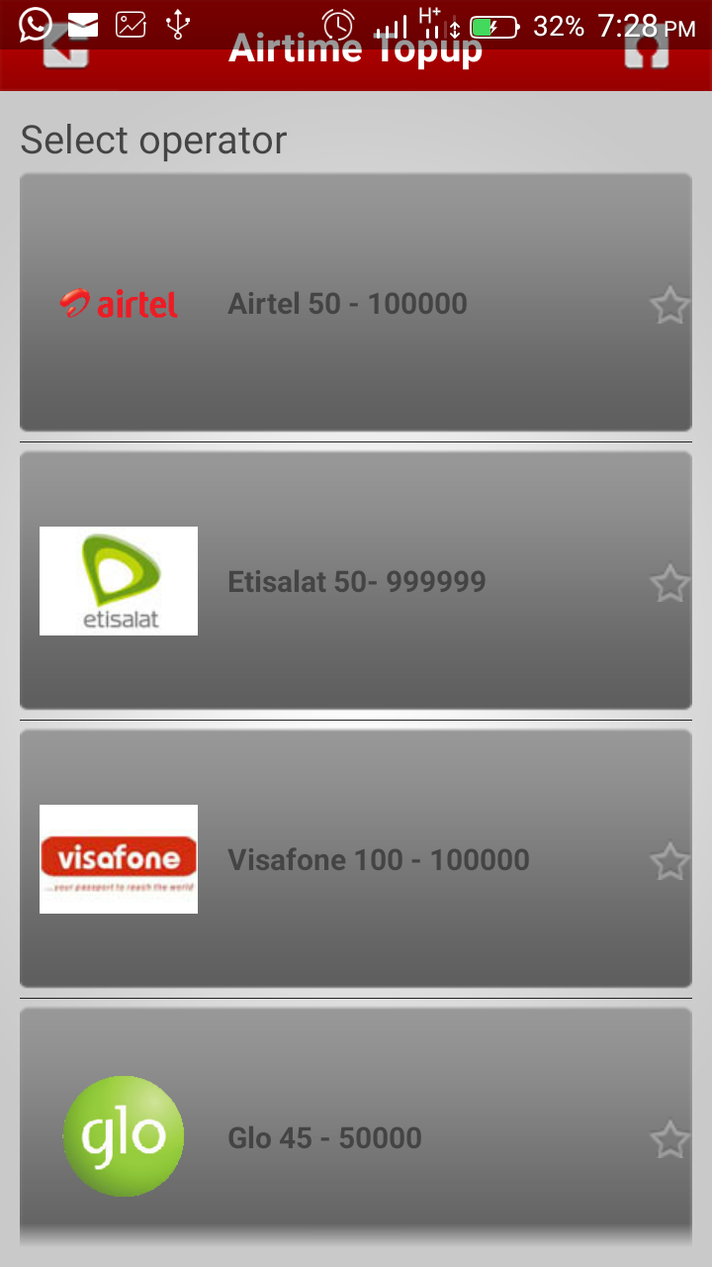
Select and click on your desired phone network you want to Top up

Slide 44
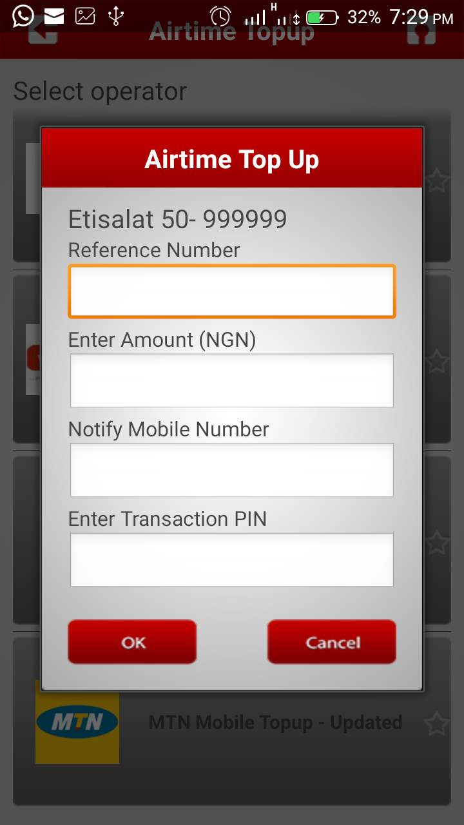
Enter the phone number you want to top up as your Reference Number
Enter your desired Amount
You may leave Notify Mobile Number blank if you wish
Enter your Transaction Pin known to you
Click OK and you will asked to confirm above entries

Slide 45
Thank you for your interest in this business.
I wish you all the best in your present and future endeavours.
Any question(s)?
Please call (+234)809 701 5999 or send an mail to info@pccontrollers.net
Website : www.pccontrollers.net
Click To Continue

Slide 46
Advertorials

Slide 47

STRATEGIES FOR GETTING AND KEEPING A TOP SEARCH ENGINE RANKING
How To Get Your Website In Any Niche Listed On The “First Page” Of Google Using instantfunders.com and others as case study

Slide 48
OLAYINKA ABIODUN FOR DONE FOR YOU SEO HOME STUDY TRAINING ON STRATEGIES FOR GETTING AND KEEPING A TOP SEARCH ENGINE RANKING
PACKAGE INCLUDES:
SEO DIAGNOSTICS SOFTWARE
20 HOURS OF COMPREHENSIVE VIDEO STUDY
100 PAGE PDF
20 HOURS AUDIO STUDY
SIX MONTHS SEO CONSULTANCY ACCESS
N25,000 TODAY ONLY ELSE N35,000

Slide 49
OLAYINKA ABIODUN FOR DONE FOR YOU 3 in 1 WEBSITE DESIGN + SEO + eCURRENCY HOME STUDY TRAINING
Attend My 3 in 1 Dynamic Website + SEO Practical Seminar + Website Hosting/Reseller Business OR eCurrency Trading For 2 days and Discover How To Make 99% LOSS PROOF Unlimited Profits Within Weeks - Guaranteed

Slide 50
In this no stories, just straight to the point practical training seminar you will be taught the easiest method of what I have been doing to chunk in millions of naira in sales.
Learn How To Use My Super Easy Website Builder Software To Effortlessly Build Highly Interactive Website Without Assistance.
You Will Learn How To Generate More Targeted Traffic to Your Website In Order To Make More Money And How to Start A Website Hosting/Reseller Business OR eCurrency Trading

Slide 51
You will also learn to attract and sustain targeted website visitors to your website
How to convert prospective visitors to your website into customers
I want you to know that your website will be dead in no time unless you attract targeted visitors who want to buy what you're selling.

Slide 52
I will only be teaching you what I know and what I do to make money and not theories like what the others teach. I will be teaching what the successful online marketers do and NOT what they say.
I am looking for skeptics that I can turn into testifiers. Simply, I AM LOOKING FOR YOU
Course fee N20,000 TODAY OR N30,000 afterwards

Slide 53
Learn How To Develop World Class E-Commerce Websites Like Jumia.com, Konga.com etc Without A Professional Website Designer.
Fee N45,000 TODAY OR N55,000 afterwards

Slide 54
Learn How To Develop World Class Websites With Joomla, Wordpress Without A Professional Website Designer.
Fee N45,000 TODAY OR N55,000 afterwards

Slide 55

The NEW 2014 Magic Jack Plus
NEVER PAY A PHONE BILL CALLING USA OR CANADA AGAIN!
Setup in seconds with any phone or simply hook up to any internet enabled PC and off you go.
No Contracts, No Cancellation Fees, No Credit Card or billing info required - because there is no monthly phone bill to pay when you use a MagicJack PLUS.

Slide 56


Now you too can talk for FREE and save up to N200,000 a year! just by calling the U.S and Canada phone numbers from Nigeria.
Simply make the Magic jack Plus Your Main or Backup Phone Line and enjoy unrestricted calls to all U.S and Canada phone numbers.
How it works
Buy once, becomes yours forever and use for a lifetime

Slide 57
PERFECT MONEY FUNDING MADE EASY!!!
Get your Perfect Money Account funded in a secured and trusted environment that makes your account safe. We are amongst the most Trusted and Tested E-currencies Exchangers in Nigeria since 2005
YOU CAN MAKE LARGE PAYMENTS INTO OUR BANK ACCOUNT AND GO TO SLEEP KNOWING THAT WE WILL SURELY KEEP OUR PROMISE(S). WE ARE BACKED BY OVER 20 YEARS OF TESTED AND PROVEN BUSINESS INTEGRITY!!!".

Slide 58
Advantages of funding with us...
Without any worry and loss of sleep your payments are safe with us, before long you too will have a good testimony and you will recommend us to your friends and associates:
Everyday availability of unquantifiable amount of Perfect Money. Regular stock always available (guaranteed)
OVER 20 YEARS OF TESTED AND PROVEN BUSINESS INTEGRITY, YOU CAN MAKE LARGE PAYMENTS INTO OUR BANK ACCOUNT AND GO TO SLEEP
PHYSICALLY ACCESSIBLE OFFICE (in the heart of Lagos) with long working hours you can always come to make your orders
We have got the financial strength to back up your orders
We take your orders from Mondays to Saturdays
We surely deliver on our promise or get your money back

Slide 59


Reliable & Affordable Web Hosting Including Reseller Hosting Plans

Slide 60
Attend absolutely FREE FOREX TRAINING for 2 weeks or more without paying a dime provided you will open a FREE forex trading account and trade with us (which is not mandatory)
Included in our absolutely FREE training classes are:
Money management
Introduction to Forex, commodities and trading Forex
100% welcome bonuses rewarded to traders should there be losses
Should there be a need for weekend class for the segment of people who have Jobs to attend to during working hours special weekends classes shall be organized.
Open a FREE NO OBLIGATION online trading account at https://www.ironfx.com/en/register?utm_source=16008385&utm_medium=ib_link&utm_campaign=IB

Slide 61
Trade on Binary Options and Make up to 81% profit within 1 hour. You can trade on: Currencies, Stocks, Indices, Commodities etc
You pay No Commission, No Spread, No Fee to start
Open a FREE NO OBLIGATION online trading account at
http://aff.azbinary.com/l.aspx?A=9229

Slide 62

Here At Last !
Your Passport To Financial Freedom
This New Discovery Helps You Start A Travel Agency, Buy Cheap Items At Wholesale Prices, Make Continuous Money And Enjoy 'Free' Holidays Within Weeks. Guaranteed

Slide 63
Amazing Discovery...
Without working too hard, you will discover one of the greatest gold-mine on how to make easy money even while you sleep and enjoying your holidays. You will discover:
How you too can make $7,000 repeatedly within weeks
How To Shop For Fast Moving Items And Pay At Wholesale Prices.

Slide 64
How To Make EASY Money Every Week And Enjoy "Free" Holidays Today Starting From Scratch. Know this secret and be financially free.
A Startling Fact About How To Make Money Every Week And Pay Next To Nothing To Enjoy "Free" Holidays in 5 Star Hotels Anywhere In The World.
Proven Verifiable Facts And Unsolicited Testimonials From People Around The World That Are Already Making Monies Via This Program. Perhaps This May Be The Secret Of Your Neighbours Wealth And The Answers To Your Long Time Prayer.

Slide 65
A Step By Step Guide On How YOU TOO Can Make Easy Money Right Here In Nigeria Including A FREE eBook On How To Get Started
Have access to tons of money making ebooks/tools with 100% resale right that you can sell and make money
Get a customised Visa Card
And much more..
Make an Appointment to attend our FREE 1 hour Seminar at
http://www.pccontrollers.net/free_training/index.php

Slide 66

Great New Discovery Helps You Make Money Every 'Green Monday' And Enjoy 'Free' Holidays Within 30 Days. Guaranteed
http://avenuestowealth.com/pccontrollers

Slide 67

This product is not just another supplement, it is curative and the effects can be seen in under 24 hours. Try it and see for yourself. It's Natures Pure Miracle!

Slide 68
This amazing curative Herbal Wonder helps sufferers of:
Diabetes
Weak Erection
Typhoid and Malaria
Vaginal Discharge
Menstruation anomalies
High Blood Pressure
Waist, Back and Joint
Pains
Fibroid

Slide 69
This amazing curative Herbal Wonder helps sufferers of:
Infertility (Male and Female)
Gonorrhea/Staphylococcus
Syphilis
Pile
Obesity/Stomach Troubles
Detoxifies the Kidneys and tones the Liver
Price N2,500 Call/sms to buy
Visit http://www.ruzubitters.com/pccontrollers
OR http://www.ruzumiracles.com/pccontrollers

Slide 70

Abundance In A Hostile Economy Empowerment Seminar
Learn how to :
Be RECESSION PROOF at any time of recession.
Turn your recession into prosperity.
Be healthy and wealthy in time of recession.
Amongst several others
Date : This Monday or As Desired Time : 10am
Venue : 21/23 Aromire Avenue Ikeja, Lagos
Fee : Absolutely FREE
To register/attend send FLP, your NAME, STATE (eg Ikeja Lagos) and BEST EMAIL ADDRESS to WHATSAPP NO 08097015999

